Slide 1


Project 3
DAB 303 Marketing Analytics
Group S2 - 2
Alfred George,
Deepa Taneja Chawla,
Nikulkumar Devataja,
Prathap David Carlo,
Rajesh Gandham

Slide 2
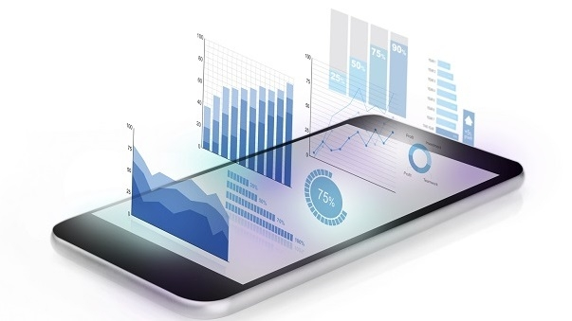
Mobile App Behavior Analysis
Market: Customers who have signed up for the free version of the app
Goal: Directing customers to paid subscription
Objective:
Predict users that will not subscribe to the paid membership
Recommend strategies that will convert the free users to get paid membership and become subscribers by targeting marketing efforts.

Slide 3
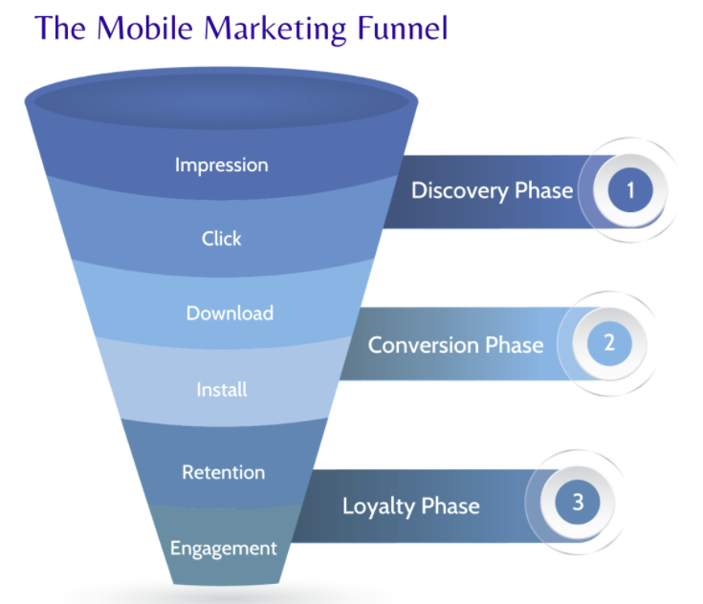
Mobile App Behavior Analysis
Research Questions
How’s the mobile app doing?
Are users doing what we want them to do?
Where and why do users drop off?
How do we plug the leaks?
What are the most crucial screens?
How users move at app and where do we lose users?

Slide 4

Data Source Review appdata.csv popular_screens.csv
Original Structure: 11 Features & 50,000 Records
Categorical: 1 feature (top screens) having
58 Unique Values
Categorical
User,
Screen List
Enrolled (Target)
Minigame,
liked,
used_premium_feature
Cleaning and Preprocessing
Hour converted to Int32 from Object
Enrolled date empty for those who are not enrolled (18926 Records)
Some users were duplicate (126 Records)
Hour represented as time of the day, converted to integer
Added Feature :
Added Difference in mins/hours between open date and enrolled date after converting them into datetime
Numerical
Age,
Day of the week,
Number of Screens
Ordinal
enrolled_date,
first_open,
Hour

Slide 5
Enrolled is the variable of interest
Pre-Processing – Feature Engineering
- Mapped screens lists in appdata with top screens to groups and the number of screens belonging to field
- Converted famous screens into features with hot encoding and Scalar encoding
New Structure
Target Variable : Enrolled
Features : 50

Slide 6

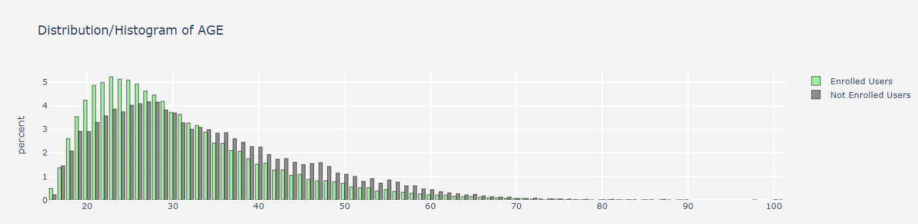
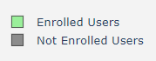
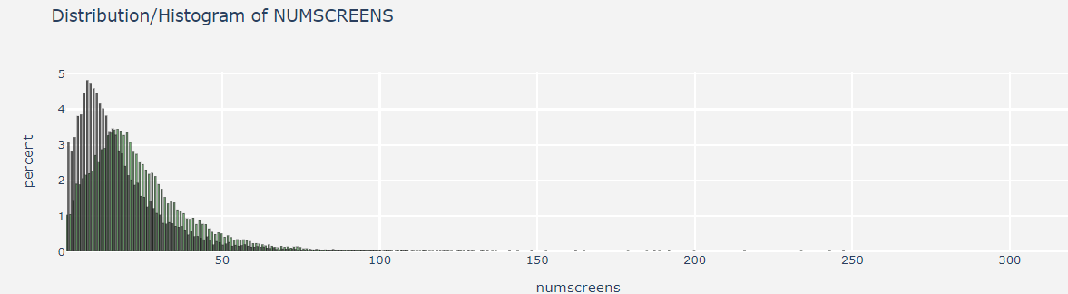
Insights from Histograms
Age Distribution
There are around 40000 people are found to be young to use the gaming app, 15000+ people in their 30's while approximately 10000 people are above 35 years.
Number of screens Distribution
42000+ users fall well within 30 screens visitation which 85%. These screens contribute more for the user to stay in the app for a long time.

Slide 7
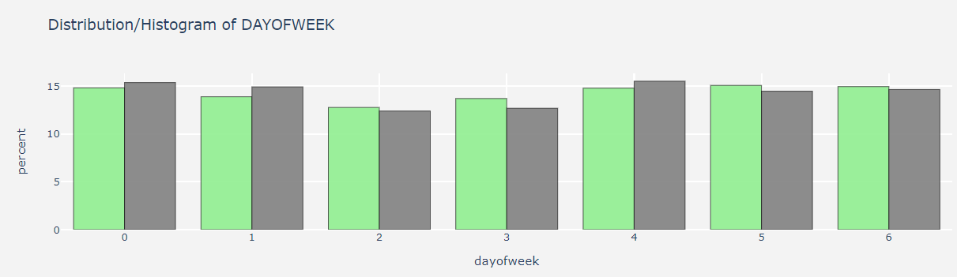
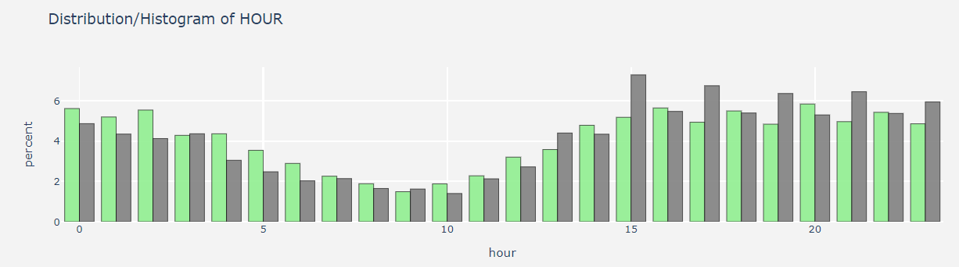
Insights from Histograms …. Contd
Distribution in Day of the Week
Overall observation is that customers are spending almost similar time over the week however slightly more on weekends.
Distribution of Hour
No of Customers staying in the app for greater than 10 hours is more compared to customers staying in the app for less than 10 hours
.

Slide 8

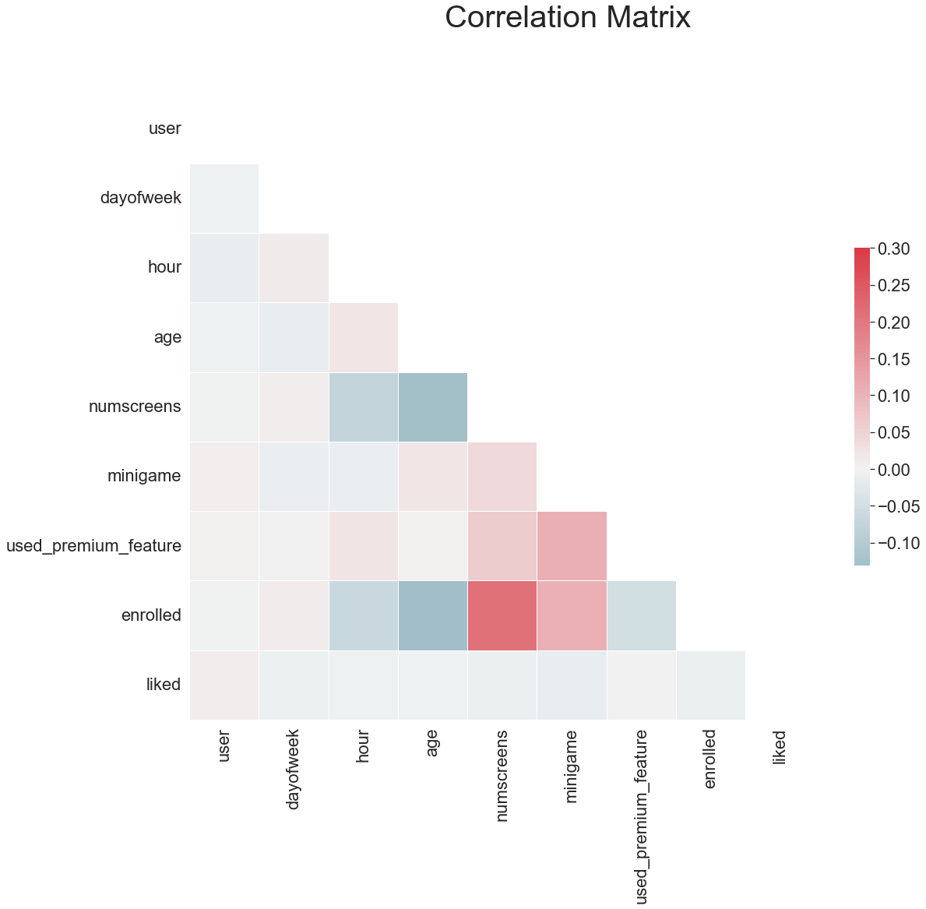
Correlation with Response variable
Positively corelated
Number of screens - 0.21%
Mini game - 0.10%
Implications :
Mini Game & Number of Screens are positively associated with our target variable. If they view more screens and play minigame they are more likely to get paid membership.
'Age’, 'Used Premium Feature and 'hour', 'liked' are inversely correlated with enrolment that is with the increase in these variables have an inverse effect on the customers enrolment.

Slide 9
Exploratory insights
Younger users have higher enrolment percentage, higher non enrolment rate among people above 40.
Number of screens visited by enrolled customers are way more than the enrolled customers.
3. Higher number of users who used the premium feature did not enrol.
4. Enrolment percentage is higher among people who played the minigame.
5. Day of the week and hour usage is similar among enrolled and not enrolled users.
6. Several features have weak negative and positive correlation among them for example Number of screens is also positively associated with premium feature and mini game but negatively associated with age and hour( used_premium_feature and minigame(0.108), Age and numscreens(-0.128))

Slide 10
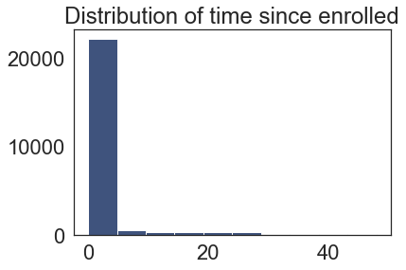
Further Exploration
Free version of the app available only till 24 hours after the open of the account
22000 Customers have enrolled into paid membership after the open of the account in less than 5 hours
Very few customers have delayed for up to 24 hours.

Slide 11
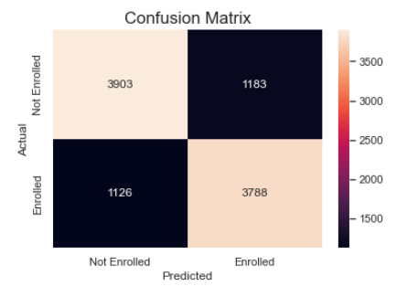
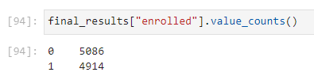
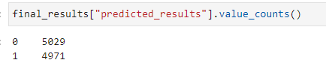
Model Deployment - Key Findings
Regression Model to predict enrolment
Overall Accuracy – 77%
Precision score -76.18%
Recall score -77%
F1 score -76.62%
0.77 accuracy with a standard deviation of 0.00 with K-Fold and Regression. Predicted results are very close to actual results.

Slide 12
Recommendations
We saw that people who used prime feature were not enrolling we should try padding the onboarding experience with helpful “how-to” content covering those features. Measure adoption rates prior to and following the change.
We saw that with age the customer onboarding decreased, we should try ramping up support crew around those users, or surveying those users to uncover any unforeseen issues.
We noticed that customers signed up within 6 hours, we should offer offer incentives or discounts to entice them to stay during those key turning points.
We should take more time to truly understand the critical customer journey - determine which path is the most critical to success. “Critical paths to success” equate to sequences of actions a user takes that lead to enrolment.
With the help of this model we should further dive into our most valuable customer segments? Which ones have the most potential to increase their spending habits, become brand ambassadors, identifying key segments will help maximizing ROI.
Further study, user reviews, could play an important role in measuring app’s usability. Both positive and negative reviews can help us identify improvement areas in the design and user interface. We should be trying to minimize the negative reviews and maximize the positive ones.
Screens funnel helped to create other features which was then used to create the model. We should study the correlation in those features to understand the user path.

Slide 13
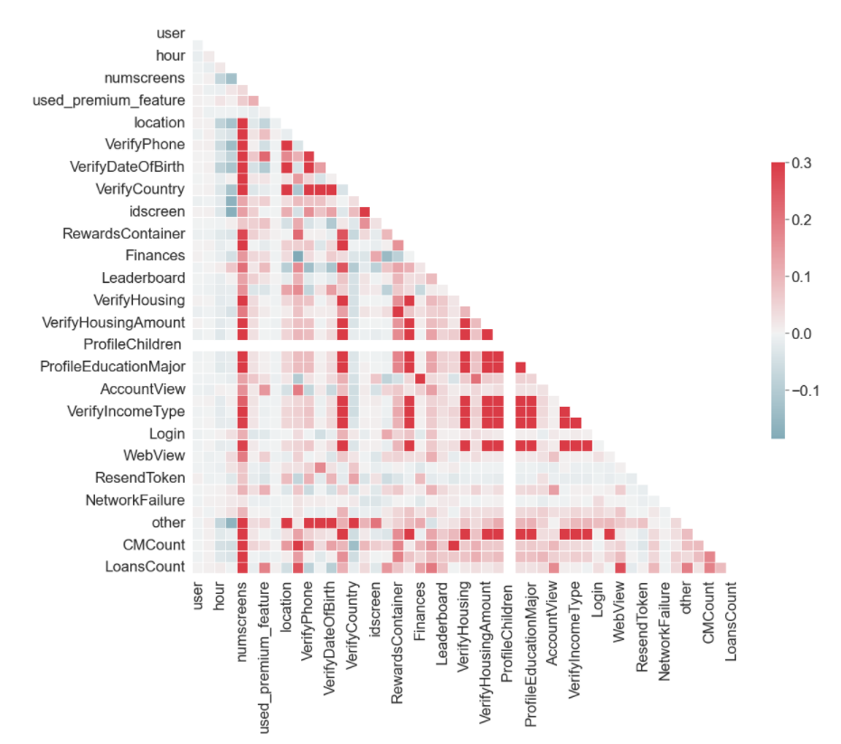
Correlation among new features
Study More Into these features and screen types

Slide 14
Recommendations
Number of Uninstalls per Week/Month. The number of times users uninstall app is another general indicator of app’s usability. Just like app downloads, it should also be measured weekly or monthly based on the general frequency of downloads. Poor user experience is one of the primary reasons apps get uninstalled.
Measure App Usability by using any of the tools such as -- FLURRY ANALYTICS, -- GECKOBOARD, -- LOOKBACK and -- APPSEE
Use A/B testing to improve funnel’s conversion rates
Learn new ways in which app can grow.
We feel that many data points can be added by reviewing following questions in conjunction with data we have
- Whether the user is a first-time or returning user;
- How frequently the user is launching the app;
- How long a person uses the app per session;
- Which areas of the app are utilized during a particular session;
- How much time people spend on area of the app;
- What errors occur while the app is in use;
- What screen person visited prior to uninstalling the app;
- What device and operating system each user is running;
- The loading time for the app and specific pages within the app;
- How long it takes the server to respond to the app’s request for data; and
- How long it takes data to travel from the server to the app.

Slide 15
They should look at this analysis insight with following questions
- What are the most common entry points to product purchase?
- What are the most popular paths to purchase?
- Which product features drive conversions or boost usage rates?
- Which perceived benefits resonate most with customers?
- How do discounts and incentives impact customer retention?
- Define every step in the user journey.
Thank you

